Slide 2
So, you think you know about pigs?
#Oink

Slide 3
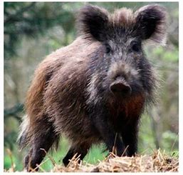
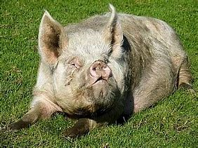
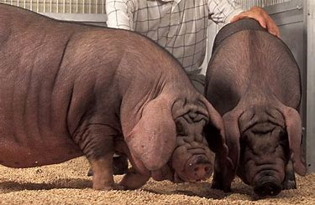
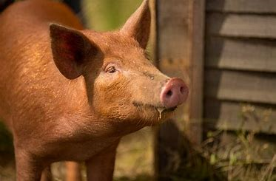
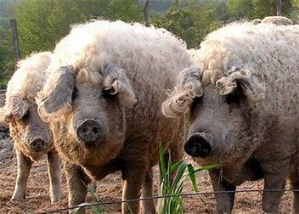
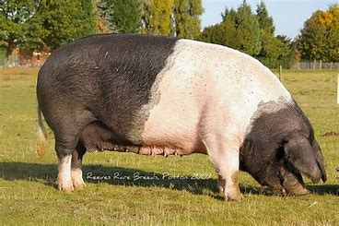
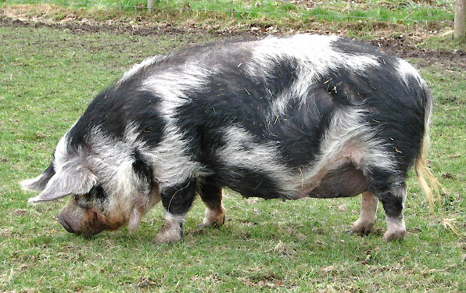
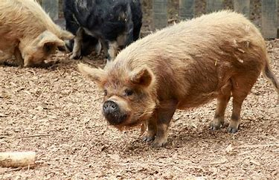
How would you describe these pigs?
#Oink
How would you describe these pigs?
How are the similar?
How are they similar?
How are they different?

Slide 4
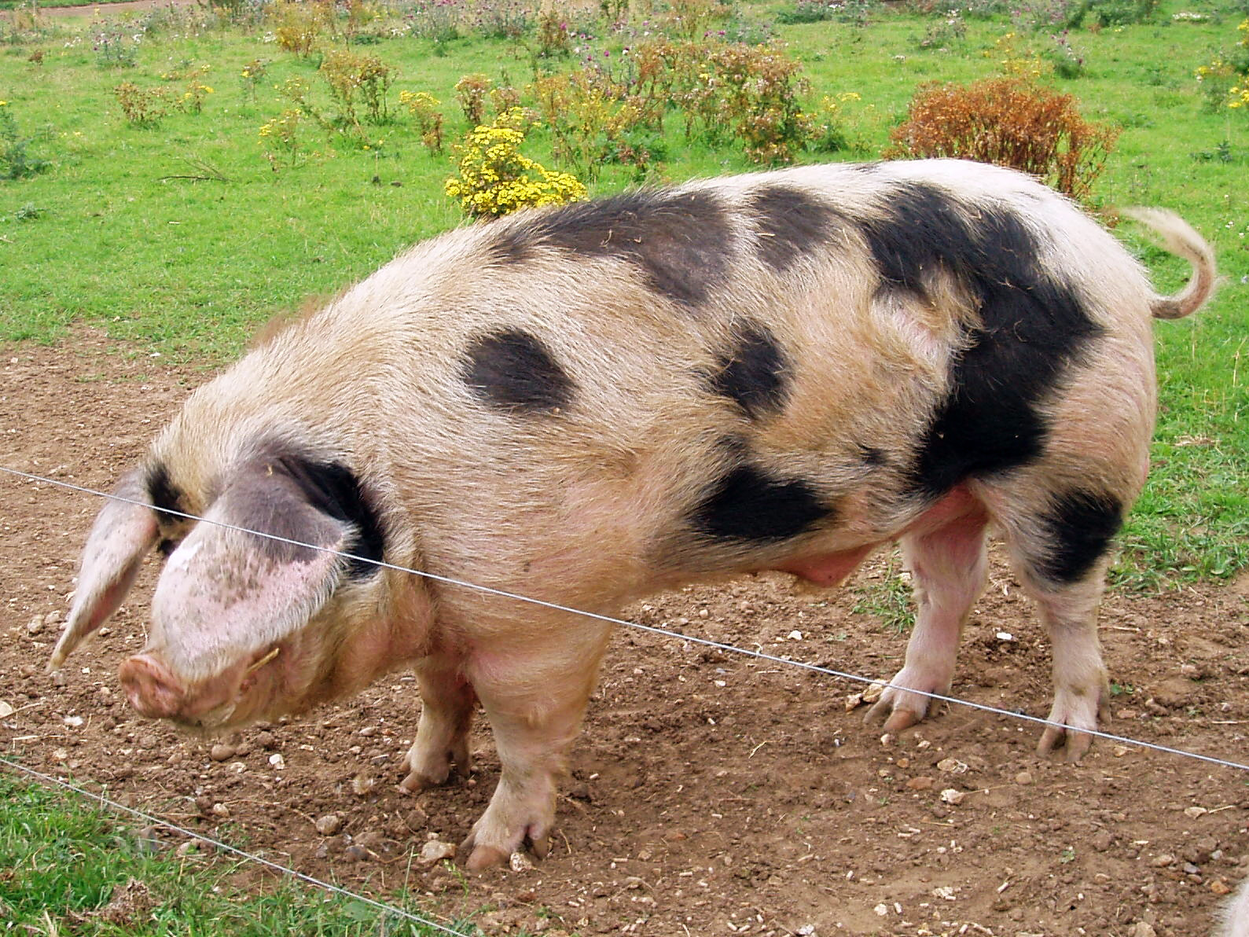
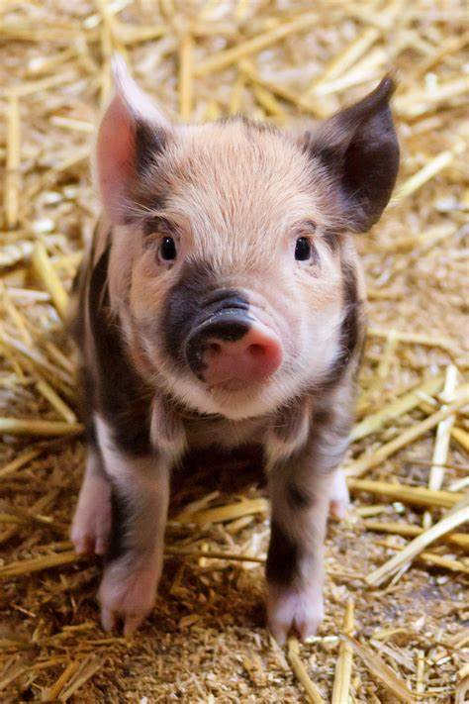
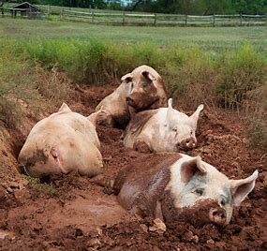
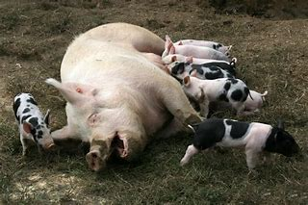
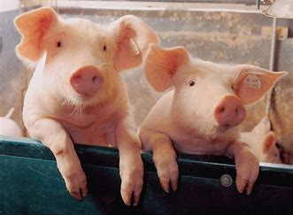
Can you match the descriptions to the pictures?
Gilt (a female pig that has not had any piglets)
Piglet
(a young pig)
Weaner (a young pig that is eating solid food and no longer needs its mother)
Sow (a female pig that has had piglets)
Boar (an adult male pig)

Slide 5
True or False?
Pigs are very intelligent
Pigs are clean animals
Pigs live on every continent across the world
Pigs have 4 toes on each foot, and walk on all of them
In China, pigs are seen to be lucky
Pigs are very messy eaters
Pigs are very peaceful animals unless provoked
Pigs can’t get sunburnt
Pigs do not have any teeth
Pigs have a great sense of smell

Slide 6
True or False?
TRUE
FALSE
Pigs are clean animals
Pigs live on every continent across the world
Pigs have a great sense of smell
Pigs have 4 toes on each foot, and walk on all of them
Pigs do not have any teeth
In China, pigs are seen to be lucky
Pigs are very messy eaters
Pigs can’t get sunburnt
Pigs are very intelligent
Pigs are very peaceful animals unless provoked

Slide 7
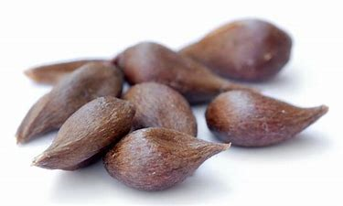
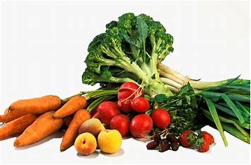
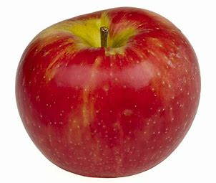
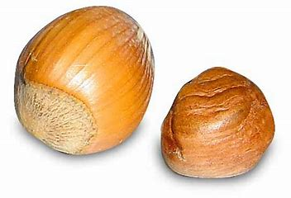
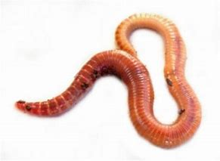
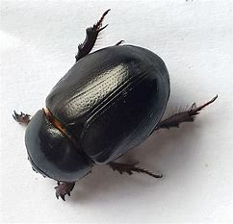
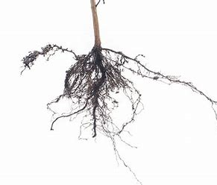
What will pigs eat?

Slide 8
What will pigs eat?
Pigs are omnivores and will eat anything (fruit, vegetables, roots, seeds, insects and even dead animals.)

Slide 9
Watch the #Oink video

Slide 10
Why are there pigs on the farm?
Pig bones are used to make water filters
Shoes are made from pig skin
Pig bones are made into buttons
Pig skin is used to make footballs
Rubber and plastic contain pig fat
Pig fat is used in paint for cars
Weed killer contains pigs’ fatty acid
Pig ears are fed to dogs
Pig fat is used to make crayons
Pig blood is used in many medicines
Pig skin is used to cover arm chairs
Pig fat is in make up
Pigs’ hearts are used for their heart valves
Pig hair is used in artists’ brushes
Calcium from the bones goes into yoghurts

Slide 11
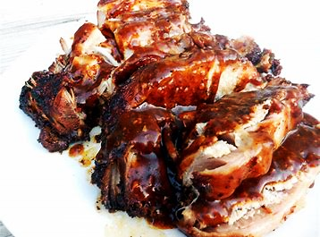
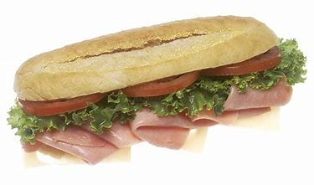
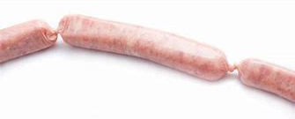
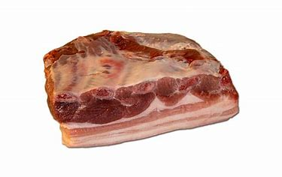
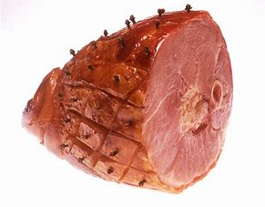
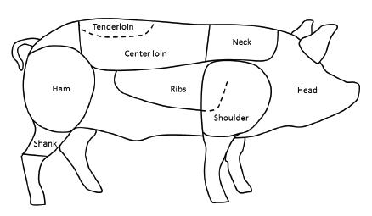
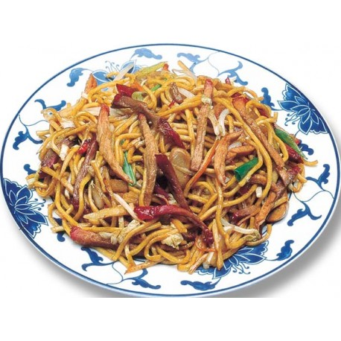
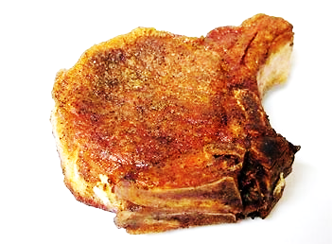
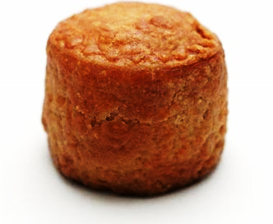
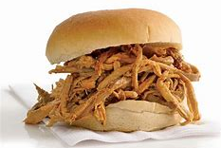
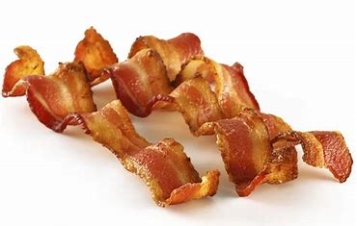
Pigs also taste nice…..

Slide 12
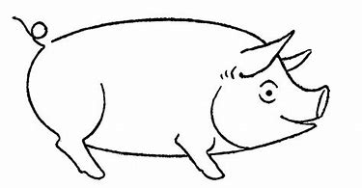
Can you design the perfect pig?
What features would they have?
Ears
Eyes
Shape
Skin colour
Hair
Size

Slide 13
LEAF Open Farm Sunday
7th June 2020
LEAF Open Farm Sunday, managed by LEAF (Linking Environment And Farming), started in 2006. Since then over 1600 farmers across the UK have opened their gates and welcomed 2.2 million people onto their farm for one Sunday in June each year.
It is a fantastic opportunity for everyone, young and old, to discover at first hand what it means to be a farmer and the fabulous work they do producing our food, enhancing the countryside and all the goods and services farmers provide. Most events are free for you to visit too.
Each event is unique based around the farm’s individual story. Activities during the day may include a farm walk, nature trail, tractor and trailer rides, demonstrations, pond dipping, activities for children, a mini farmers market or farm shop.
Find this year’s date and search for your local farm here: https://farmsunday.org/visit-a-farm

